Slide 1
SSLEP Local Growth Deal (LGD) report Q3 - 2021-22
Executive Board 17th February 2022
Report author: Sharon Palphreyman, SSLEP Programme Manager

Slide 2
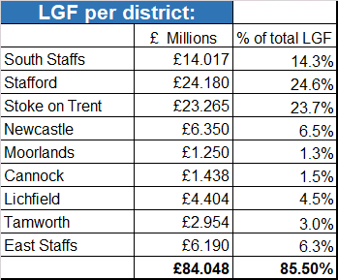
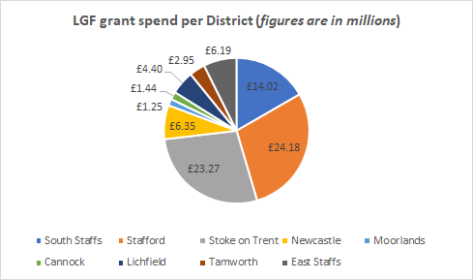
SSLEP Local Growth Deal (LGD) report Q3 - 2021-22
Local Growth Deal Position
This report provides a summary of outputs and match funding reported during Q3, programme highlights and issues reported in Q3, and the progress of live schemes.
March 2021 was the end of the LGD grant spend period; the full amount of grant had been spent by the deadline: £98.27m.
NOTE: The remaining £14.17m (14.5%) was spent on county-wide schemes or schemes that cross more than one area, such as LSTP, SME expansion programme and Economic Regeneration programmes.
Note: Figures above do not include County-wide multi-location schemes such as Local Sustainable Transport Programme or SME Expansion Programme.

Slide 3
SSLEP Local Growth Deal (LGD) report Q3 - 2021-22
LGD programme – current position
A total of 37 schemes were offered LGD grants; 4 were withdrawn before drawing down any grant and the funding was reallocated to new schemes during the grant period. Of the 33 that received LGD grant:
2 schemes were funded for preliminary work only (now being progressed outside LGD timescales). Match funding is being reported
11 schemes have totally completed – scheme complete, outputs delivered
13 schemes have physically completed but still have some or all outputs to deliver. Outputs and match funding will continue to be reported.
7 schemes are still active/in progress. The remaining work is being funded via match funding pledged to the scheme. Progress, outputs and match funding will continue to be reported.

Slide 4
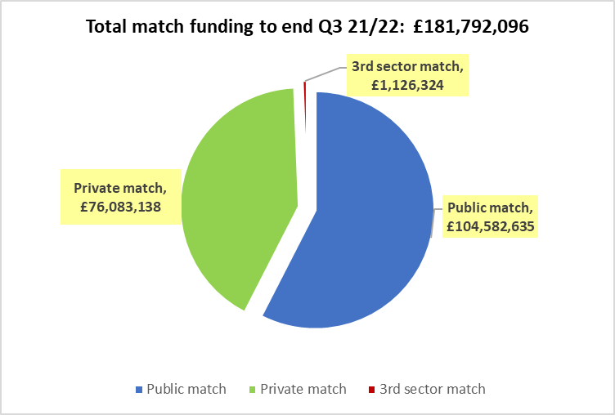
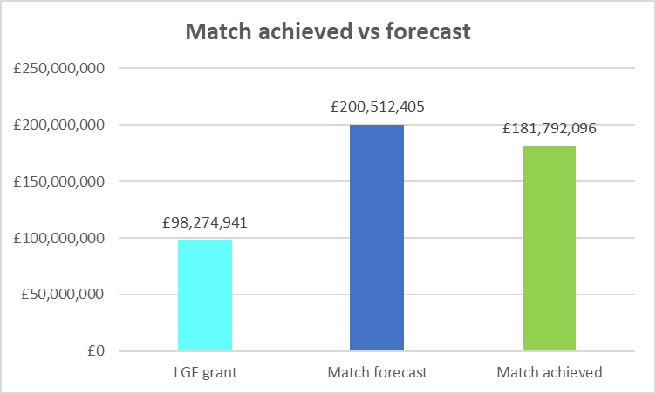
SSLEP Local Growth Deal (LGD) report Q3 - 2021-22
Wider scheme finances
Forecast budget:
The total forecast budget for delivery of the schemes receiving LGD grant is: £298.8 million
Of which £98.3 million is LGD grant
Of which £200.5 million is match funding
Match spend (to deliver the scheme)
Actual match spend reported to end of Q3 20/21 (rounded):
Total match funding reported: £182 million
Of which public match is: £105 million
Of which private match is: £76 million
Of which 3rd sector match is: £1 million
90.66% of the total forecast match funding has been spent by the end of Q3.

Slide 5
SSLEP Local Growth Deal (LGD) report Q3 - 2021-22
Leverage - resulting from the LGF enabling schemes
This will be calculated annually. To the end of year 2020/21, £185.37million private investment is calculated to have been invested in the area as a result of the SSLEP LGD programme of schemes.
It is estimated that, as outputs are realised and schemes mature, forecast total private investment leverage will be in the region of £1.25 billion.
Forecast is based on figures provided as part of business cases (which would have been subject to, and part of, the appraisal process), and detailed in contracts, based on the approximate number of homes to be built and sqm of commercial land to be developed.
The leverage Outputs are based on the following calculations:
Industrial
Calculated using a build cost calculation of £70 per square foot (attributed to Bericote, Meaford and Lichfield Park), although the £110m estimate at Bericote for Gestamp also includes fit out and equipment investment)
Residential
Calculated using a (conservative) build cost calculation of £90 per square foot (this is a number SCC reported seeing in viability appraisals in April 2020) and a conservative assumption that each house is approximately 1,000 sq ft, giving a very crude leverage of approx. £90,000 leverage per house
(There is extra leverage from items like estate roads, utility provision, dealing with abnormal costs etc. but sponsors don’t have the resources to unpick those).
Housing
£££££
Jobs

Slide 6
SSLEP Local Growth Deal (LGD) report Q3 - 2021-22
LGD programme – Outputs to date – Housing units
SSLEP target: 1,000 houses
Houses delivered in Q3: 154
Total housing units achieved by December 2021: 708
% of target achieved to date: 71%
Overall forecast total of houses to be delivered as a result of the LGD grant-aided schemes: 6,167
% of overall forecast achieved to date: 11%
We expect to meet the 1,000 housing target in year 2022/23
Q3 - headlines
Branston Locks (residential)– build completion numbers should escalate further as 2 more developers are set to join the 2 developers already on site. One of the new developers has reserved matters approved subject to s106/s278 approval; the other is under contract and Reserved Matters to be submitted shortly. (See slide 10 for details)
SWAR – Taylor Wimpey are progressing at Burleyfields, building is well underway.
Victoria Park (St Modwen at the old Stoke City Football ground) – building is now well underway with half of the forecast homes already built.

Slide 7
SSLEP Local Growth Deal (LGD) report Q3 - 2021-22
LGD programme – Outputs to date – Jobs created
Jobs count includes jobs created and full apprenticeships
SSLEP target: 5,000 jobs
Jobs delivered in Q3: 27
Jobs achieved by December 2021: 2,916
% of target achieved to date: 58%
Overall forecast total of jobs to be created in the area as a result of the grant-aided schemes: 14,686
% of overall forecast achieved to date: 20%
We expect to meet the 5,000 jobs target in year 2023/24
Q3 – headlines
There has been considerable movement on some of the larger infrastructure schemes which had been initially slow to gain ground, negatively impacting on outputs realisation. We expect to see job outputs climb significantly in the next 6m:
Liberty Park, Lichfield – two end users on site
Four Ashes, Bericote – a further unit has recently been let.
The jobs recently delivered on these 2 sites above have not yet been added to the outputs reporting as we are awaiting confirmation of job numbers (estimated to be circa 200 jobs at Lichfield and circa 500 jobs at Bericote – these will significantly increase % achieved, once confirmed).
Branston Locks (commercial) - a start on site has now been made. The first phase of speculative units total 235,000 sq feet and are due to complete in Feb/March 2022. A further planning application has been approved for a 172,000 sq feet facility.

Slide 8
SSLEP Local Growth Deal (LGD) report Q3 - 2021-22
LGD programme – Outputs to date – Other
Jobs count includes jobs created and full apprenticeships
3,559 learners assisted to a qualification
6.5 km road resurfaced
5 km newly built road
26 km cycle/walking paths and improvement to enable sustainable transport
7,531 m2 of new or improved learning/training space
115,197 m2 of commercial floorspace created
300,000 m2 of land with reduced flood risk (reducing flood risk in 114 homes and 159 commercial)
Skills and learning
Infrastructure and sustainable transport
Enabling commercial development
Flood alleviation

Slide 9
SSLEP Local Growth Deal (LGD) report Q3 - 2021-22
Highlights reported in Q3 – (page 1)
i54 Western Extension: News - i54 (i54online.com)
Elements Europe submitted a reserved matters planning application on 25th November for their plot which should accommodate a building of circa 500,000 square feet. The employment from the Elements plot is to be confirmed but is expected to be in the order of 700+ FTE jobs. (Jobs outputs are shared with BCLEP).
Advanced discussions with another international manufacturing business which would occupy the remainder of the Western Extension continue.
SWAR: Pans Drive officially opened on 19th November 2021; the new Stafford Western Access Route is now fully open.
On-going landscaping and traffic sign works. All outstanding contract and snagging works to be complete by 28/02/2022. Agreeing scope of accommodation works with third parties.
Website: Stafford Western Access Route - Staffordshire County Council
Housing: outputs are being reported quarterly
Bellway at Mallard Walk (previously completed) – 174 homes.
Taylor Wimpey at Burleyfields: c.2,000 houses forecast. Phase 1 in progress - 427 homes. (102 built to date). Burleyfields ‧ New homes in Stafford ‧ Taylor Wimpey
Lichfield Park: Two end users now on site: AX Fleet and Super Smart.
https://www.logisticsmanager.com/fleet-management-firm-secures-midlands-warehouse/
Awaiting confirmation of number of employees - estimated to be around 200 jobs between the 2 units
Four Ashes, Bericote: A unit has been let to Ceva Logistics - awaiting confirmation of job numbers (estimated c.500 jobs).

Slide 10
SSLEP Local Growth Deal (LGD) report Q3 - 2021-22
Highlights reported in Q3 – (page 2)
Branston Locks:
Commercial site: employment development. A start on site has now been made. The first phase of speculative units total 235,000 sq feet and are due to complete in Feb/March 2022. A further planning application has been approved for a 172,000 sq feet facility.
Residential site: progressing well (96 homes in total delivered in Q3), several developers on, or soon to be on, site:
Cameron Homes Lawnswood phase 1 - all 70 units are completed and occupied
New homes for sale at Lawnswood, Tatenhill by Cameron Homes
Cameron Homes The Saplings phase 1: 58 units under construction (32 completed/occupied)
The Saplings at Lawnswood | Cameron Homes (camerongalliers.co.uk)
(Cameron Homes The Saplings phase 2 - circa 200 homes expected in total)
Taylor Wimpey – 201 units in progress (165 completed/occupied)
The Coopers ‧ New homes in Branston ‧ Taylor Wimpey
Lovell (Shobnall Rd end) – 190 homes planned – Reserved Matters approved and awaiting s106 / s278 approval
East Midlands Projects Announced | Lovell Partnerships
Crest Homes – 300 units – under contract and Reserved Matters to be submitted shortly
Victoria Ground: St Modwen Homes have completed a further 27 homes in Q3, bringing the total built to 35 (they have already delivered half of the 70 homes forecast). Victoria Park, Stoke-on-Trent - St Modwen Homes.
Keele Smart Innovation Hub has reported 24 jobs delivered in Q3.
Match funding: a deep dive into match funding on a complex scheme (shared across partners) where match achieved fell short of forecast has contributed to a total of £17.9m match being reported in Q3 (of which £11.9m is private match).

Slide 11
SSLEP Local Growth Deal (LGD) report Q3 - 2021-22
Issues: Q3 update
Blythe Park – revised scheme
SSLEP Executive Board had delegated authority to a subgroup of Board members (SSLEP Chair, SSLEP SPMG Chair and SSLEP Audit & Finance Chair) to progress the scheme and mitigate the risk to the LGD programme.
The group with Delegated Authority APPROVED a revised approach to this scheme (t-junctions instead of roundabouts), following independent appraisal of the revised proposal.
Legal work is currently taking place to draft a variation to the LGF grant agreement and GPF loan agreement to reflect the change in approach/s278 variation. Works are due to start in June/July as soon as all the SCC technical/design approvals for the S278 variation have been completed.
The LGF grant was transferred to SCC Highways in March 2021, under the legal requirements of the S278 agreement, so is classed by BEIS as "spent“.
Project visibility – in Q3 some quarterly reports have not been submitted (or may be submitted too late for inclusion in Q3 reports).

Slide 12
SSLEP Local Growth Deal (LGD) report Q3 - 2021-22
For further details regarding LGD schemes:
Please see Appendix – LGD Progress dashboard Q3 2021-22 v1
Further information for each GBF scheme can be provided on request by the SSLEP Programme Manager: sharon.palphreyman@staffordshire.gov.uk

