Slide 1
SSLEP Getting Building Fund (GBF) report Q3 - 2021-22
Executive Board 17th February 2022
Report author: Sharon Palphreyman, SSLEP Programme Manager

Slide 2
SSLEP Getting Building Fund (GBF) report Q3 - 2021-22
Getting Building Fund Position
This report provides a summary of outputs and match funding reported during Q3, programme highlights and issues reported in Q3, and the progress of the live schemes.
The deadline for GBF spend is March 2022.
Note: 1) Figures above include Drakelow Park as SSLEP remains a co-investor in the scheme.
2) Cornhill Small Business Units (Staffs Moorlands DC) has now been removed.
Q3: £51,748 remains unallocated

Slide 3
SSLEP Getting Building Fund (GBF) report Q3 - 2021-22
GBF programme – programme changes
Following the decision of SPMG to withdraw the grant GBF funding from the Cornhill scheme, to maximise GBF grant spend and as agreed at SPMG in December, the grant has been reallocated to the three schemes who were due to receive both GBF and SSLEP reserve funding (Church St. Gaming Hub / Cleveland Future Skills Hub / SEF G JCB Robotics). No SSLEP reserve funding is now required to finance the remaining GBF programme. Following reallocation of the GBF Grant, £0.052m of grant is now unallocated and will be carried forward as part of slippage.
SSLEP requested that the SSLEP GBF allocation for Drakelow Park be de-allocated from SSLEP and reallocated to D2N2. This de-risks the scheme for SSLEP and allows D2N2, who are managing the scheme, greater efficiencies in that just one LEP will now be controlling the scheme. A legal assurance agreement between SSLEP and D2N2 has been completed and the £5.05m is being transferred to DCC w/c 31/01/2022.
The revised programme now includes 13 schemes.
Contractual position: the 13 schemes currently in the programme are all contracted.

Slide 4
SSLEP (GBF) report Q3 - 2021-22 – GBF Spend to date
GBF grant spend to end of Q3. Total SSLEP allocation £18,650,000
Match funding reported to date Q1 2020/21 | SSLEP GBF grant per scheme | Total GBF spend reported to date | % of GBF allocation spent to date
Drakelow Park (D2N2 to claim outputs) | £0 | Transferred w/c 31/01/22 | 0%
The Centre for Health Innovation | £2,889,500 | £2,889,500 | 100%
i54 Western Extension (reported through LGF) | £3,000,000 | £3,000,000 | 100%
Keele Innovation Centre 7 | £6,100,000 | £2,616,029 | 43%
Creative Lab (New Enterprise Collaboratory) | £500,000 | £500,000 | 100%
Powering Up Enterprise | £2,450,000 | £789,375 | 32%
SEF C - Digital Skills Academy (South Staffs College) | £550,262 | £550,262 | 100%
SEF F - Creative and Digital Industries project phase 2 (Stoke on Trent College) | £249,523 | £249,523 | 100%
SEF H - Construction Industry Digital Technologies (CIDT) (Stoke on Trent College) | £119,757 | £119,757 | 100%
Shire Hall regeneration project | £1,600,000 | £247,532 | 15%
Staffordshire Local Sustainable Transport Package | £651,000 | £255,287 | 39%
SEF G - JCB Automation and Robotics Suite | £172,710 | £122,147 | 71%
Church Street Gaming Hub – due to commence and complete in Q4 | £190,000 | £0 | 0%
Cornhill Small Business Units - WITHDRAWN |  | £0
Cleveland Future Skills Hub | £125,500 | £41,775 | 33%
£523,252 SSLEP reserves funding was to be used as match for the 4 contingency schemes to allow all 4 to be progressed, as otherwise there would not have been sufficient GBF to cover all the schemes. The withdrawal of Cornhill has meant that GBF can now fulfil the original grant request for the other 3 schemes, and the SSLEP reserves are not needed for these 3 schemes. This currently leaves £51,748 GBF grant unallocated – to be reviewed by SPMG on 08/02/2021 | GBF allocated: | GBF actual spend to date: | % of GBF spent to date
 | £18,598,252 | £11,381,187 | 61.03%
Slippage/Freedoms and Flexibilities
Total GBF grant spend (slippage) estimated to be drawn down in Q1 22/23 using S151 Freedoms and Flexibilities: £2.584m
Comprising:
Keele IC7 £2.136m
Powering Up £246,775
LSTP £150,000
Unallocated £51,748
As agreed at the December SPMG, the accountable body using its freedom and flexibilities will do a funding switch with another SCC capital scheme to utilise all the GBF grant. This will ensure the funding is immediately available in 22/23 to fund the slippage schemes.

Slide 5
SSLEP Getting Building Fund (GBF) report Q3 - 2021-22
Wider scheme finances
Forecast budget:
The total forecast budget for delivery of the schemes receiving GBF grant is: £57.5 million
Of which £18.65m million is GBF grant
Of which £38.9 million is match funding
(Adjusted figures as Cornhill has been withdrawn)
Match spend (to deliver the scheme)
Schemes are being encouraged to spend GBF grant prior to drawing down sources of match funding, to mitigate against delays in spend during the very limited timescale of the GBF programme. However, match spend is now being reported.
Actual match spend reported to end of Q3 20/21 (rounded):
Total match funding reported to date: £4.6 million
Of which Local Authority match is: £0
Of which “Other Public” match is £2.36 million
Of which private match is: £2.28 million
11.9% of the total forecast match funding has been spent by the end of Q3.

Slide 6
SSLEP Getting Building Fund (GBF) report Q3 - 2021-22
Projects - Outputs
Outputs will be reported as they are delivered.
The first few outputs have already been reported:
17 construction jobs
(Q1 – Keele IC7)
1.1Km footpath/cycle path
(Q1 – LSTP)
770 sqm learning/training floorspace
(Q2 – SEF C 600 sqm; SEF F 170 sqm)
147 sqm commercial floorspace
(Q2 – Creative Lab)
30 sqm R&D floorspace (Q3 – Creative lab) + all specialist equipment as detailed.
Digital and construction skills
Sustainable transport
Supporting business enterprise and jobs
Innovation

Slide 7
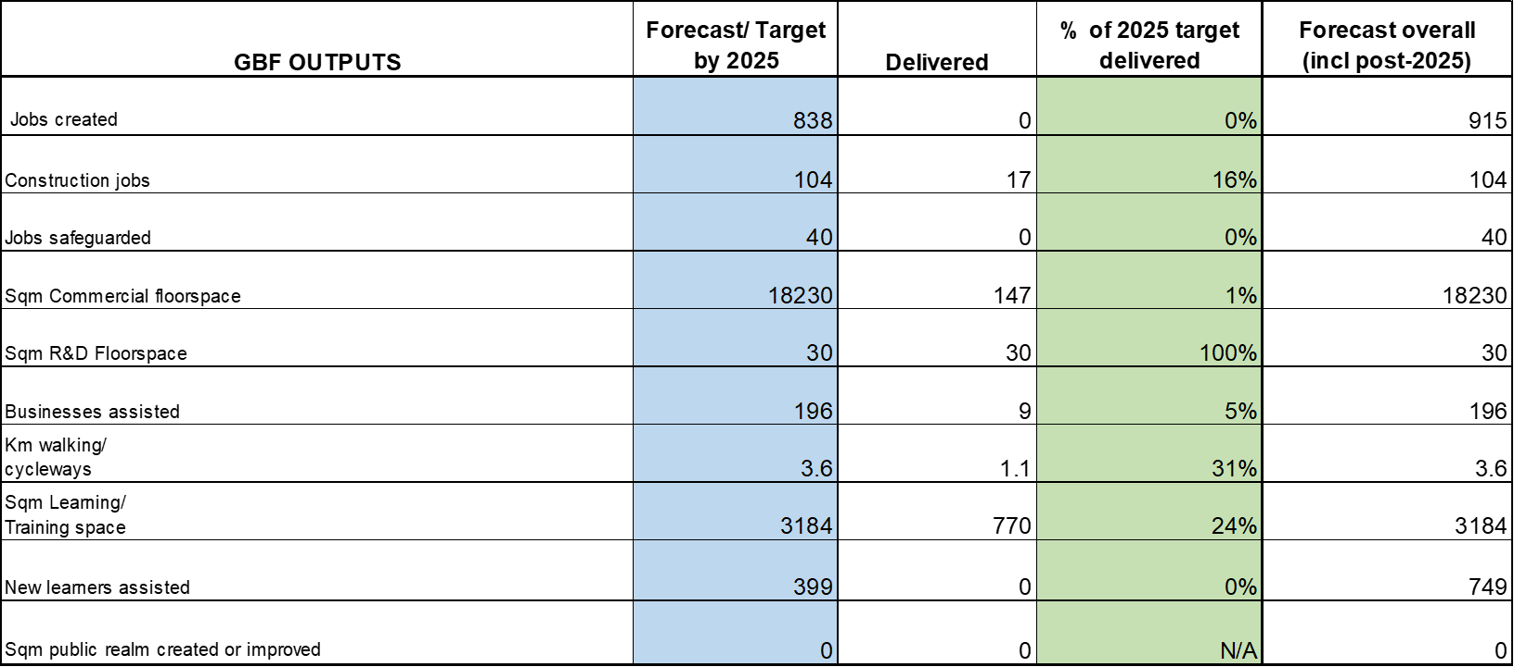
SSLEP Getting Building Fund (GBF) report Q3 - 2021-22
Forecast/Actual Outputs
Note: Outputs for Cornhill Small Business Units have been removed from the forecasts as the scheme has now been withdrawn

Slide 8
SSLEP Getting Building Fund (GBF) report Q3 - 2021-22
Outputs achieved to date

Slide 9
SSLEP Getting Building Fund (GBF) report Q3 - 2021-22
Highlights reported in Q3
Drakelow Park – a funding transfer agreement has been completed and £5.05m GBF has now been transferred to D2N2 for delivery of this scheme.
6 schemes have fully spent their GBF allocation, of which 4 have now completed.
Health Innovation Centre.
Now in the later stages of the project (in preparation to start the internal installations) with an amended practical completion date of 2nd February 2022. A comprehensive roll out of staff training on the new facilities and capabilities is ready to go.
The CHI launch event will take place on 25th March 2022.
Creative Lab
The R&D space (total of 30sqm) has been delivered and all specialist equipment installed (photos are available). Both commercial and R&D space has been utilised by staff and collaborators since September 21. The University has hosted and facilitated more than 90 users and supported 9 start-ups through various methods of delivery that this facility offers.
Cleveland Future Skills Hub: Works are well underway and scheme is on track to complete the project in the planned timescale (end of Feb). Costs have increased and some additional funding has been found. Match funding will be more than anticipated. The scheme asked if the LEP would consider allocating an additional £20k - £30k to the scheme.

Slide 10
SSLEP Getting Building Fund (GBF) report Q3 - 2021-22
Issues/updates reported in Q3
Shire Hall regeneration project – mitigated issue: this scheme reported in Q2 that there may be potential slippage, but the Q3 update hopes that GBF may now all be spent by the end of March deadline.
Slippage is expected on 3 schemes: £2.584m is forecast to be spent in Q1 22/23 (incl £51,748 unallocated)
Keele Innovation Centre 7: Forecast slippage to Q1 22/23: £2.136m. Construction has been hampered by weather, the pandemic, the presence of a third badger sett and steel supply chain issues. As a result the building is currently forecast to reach practical completion in June 2022. A spend re-profile was considered and approved by SPMG/Board in Dec/Jan.
Staffordshire Local Sustainable Transport Package: Forecast slippage to Q1 22/23: £150,000. Reported a 3 month delay in the delivery of the A444 Burton-Swadlincote cycle route, due to the following reasons:
The scheme has secured an additional local contribution of £150,000 from DfT Paths for Everyone fund, managed by Sustrans. A better scheme along the A444 can now be delivered that meets new Government guidelines. The enhancement of the scheme and the need to meet Sustrans approval processes has caused some delays to delivery. The additional funding has had the added benefit of increasing match funding.
Lead-in times on construction, related to COVID-19
Powering Up Enterprise: Forecast slippage to Q1 22/23: £246,775
The project is made up of five schemes, two have been on site for some time and will be completed in February (Clayworks and Smithfield) and have spent 53% (£562,000) of their GBF in Q3. Three schemes have been out to tender and contracts are to be awarded this week: Swann House, Spode No.5 and Longton Town Hall. SPMG have recommended removing CoRE from the portfolio of projects (although this decision is currently awaiting Board's ratification). A further £250K of Heritage funding has been secured to support the Spode No 5 site. The City is contributing an increased match of £850,000.

Slide 11
SSLEP Getting Building Fund (GBF) report Q3 - 2021-22
For further details regarding GBF schemes:
Please see Appendix – GBF Progress dashboard Q3 2021 v1
Further information for each GBF scheme can be provided on request by the SSLEP Programme Manager: sharon.palphreyman@staffordshire.gov.uk

