Slide 1


Skills and Economic Challenges in Newcastle-under-Lyme
Skills and Employability Team,
Staffordshire County Council

Slide 2


Introduction
Provide insight into current and future skills demand and supply challenges in Newcastle-under-Lyme

Slide 3


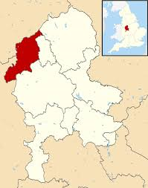



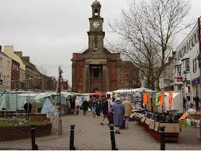
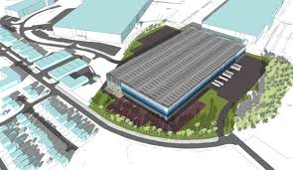

Recent success in creating new businesses and jobs
510 additional businesses since 2011
Business start-up rate is the lowest of all Staffordshire LAs and lags well behind regional and national averages
However, businesses are less likely to fail
9,000 additional jobs since 2011
2nd Highest increase in jobs of all Staffordshire LA’s and a higher rate of jobs growth than the regional and national averages
Notes:
Total Businesses – 3,530 in 2019 (Source: UK Business Counts)
Business start-up rates per 10,000 – Newcastle 36.5 / Staffordshire 47.1 / WM 66.0 / England 75.2
Business death rates per 10,000 - Newcastle 35.5 / Staffordshire 43.8 / WM 55.8 / England 65.9
3 Year business survival rates – Newcastle 56% / Staffordshire 59% / WM 56% / national 55% (declining trend across all areas)
(Source: ONS Business Demography 2018)
Jobs growth rate 2011-2018 = Newcastle 2nd highest (19.6%) of all Staffordshire LAs and above regional (12.3%) and national (13.5%) averages
Job density (jobs per working age pop) = low (0.67) compared to regional (0.81) and national (0.87) averages
(Source: ONS Job Density 2018)

Slide 4
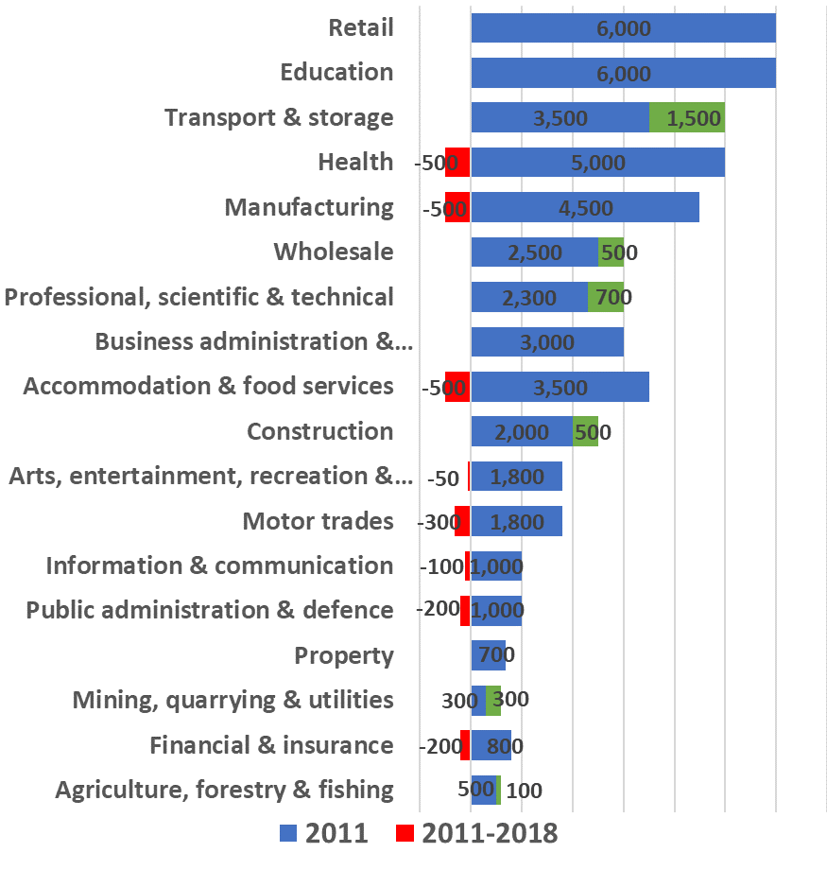
More balanced economy with jobs growth in service based industries and declines in public and financial sectors
47,000 jobs in 2018
Largest sectors are retail and education (both 6,000 jobs) followed by distribution with 5,000
Rebalanced the local economy – strong growth in distribution (+1,500), professional services (+700) and wholesale (+500)
Clear impact of the recession on the financial sector and ensuing austerity in public sector as well as some manufacturing decline
An economy that feels more resilient to economic shocks…
Notes:
(Source: Business Register and Employment Survey (BRES) 2018)

Slide 5
Lower rates of unemployment claimants and youth unemployment than seen nationally
Notes:
Claimant Count Rate (June 2020): 4.8% or 3,945 claiming JSA or Unemployment Universal Credit, lower than the Staffordshire (4.9%) and national (6.4%) averages (Source: DWP Claimant Count)
Economic Inactivity (Apr 2019-Mar 2020): higher level of economic inactivity than Staffordshire and national averages
Newcastle 22.7% / Staffordshire 18.0% / national 20.6% - 19.8% (Source: Annual Population Survey)
Youth Unemployment (aged 18-24) (June 2020): Lower rate of young people (aged 18-24) finding themselves unemployed than the Staffordshire and national averages - Newcastle 6.5% / Staffordshire 8.3% / national 9.1% - 910 18-24 claimants in June 2020 (Source: DWP Claimant Count)

Slide 6
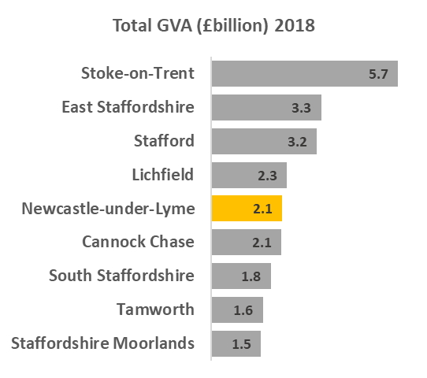
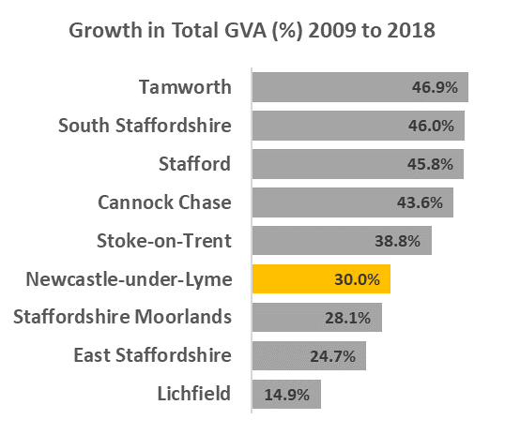
Lower than average growth in the economy, driven mainly by increase in services sector output
WM = 43.4%
UK = 35.5%
Staffs = 33.4%
Notes:
Size of economy 2018: £2.1billion
GVA growth 2009-2018:
Total £496million (30%)
Services sector (wholesale, professional and distribution) £410million
(All seen an increase in jobs)
(Source: ONS Regional gross value added (balanced) by local authority 2018)

Slide 7
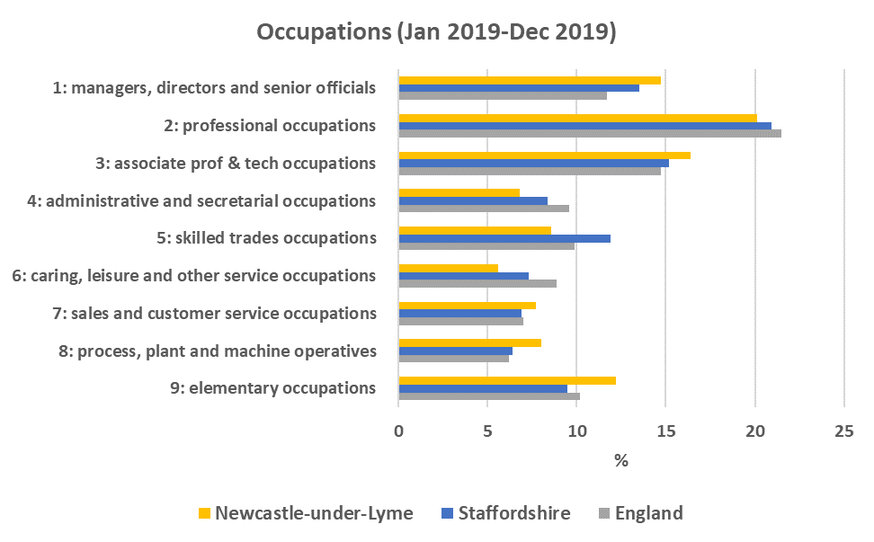
Newcastle-under-Lyme is in-line with Staffordshire and national averages in terms of jobs in higher occupations
Around half (51%) of jobs in Newcastle-under-Lyme were in the top 3 occupation groups in 2019, which was in-line with the Staffordshire (50%) and national (48%) averages
Notes:
Occupations (2019):
Increase in the % of jobs in the top 3 occupation groups from a third (33%) in 2009 to over a half (51%) in 2019 equivalent to 60% or 11,700 more residents employed in these higher occupations and in-line with the Staffordshire (50%) and England (48%) averages.
(The top three occupation groups are: ‘managers, directors and senior officials’, ‘professional occupations’ and ‘associate professional & technical occupations’)
(Source: Annual Population Survey)

Slide 8
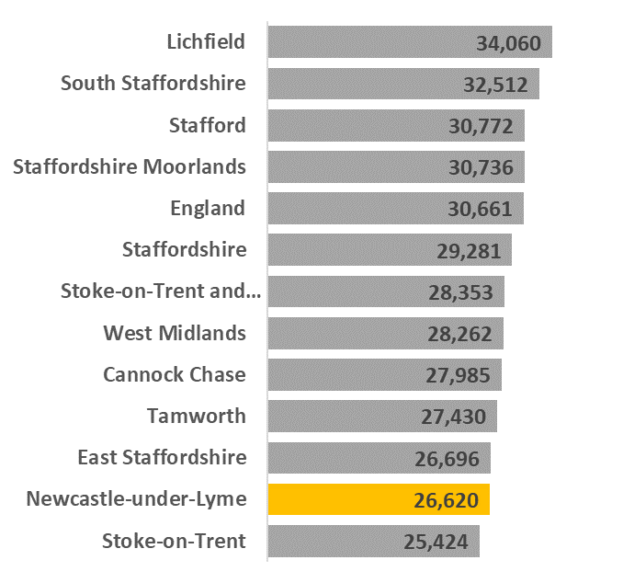
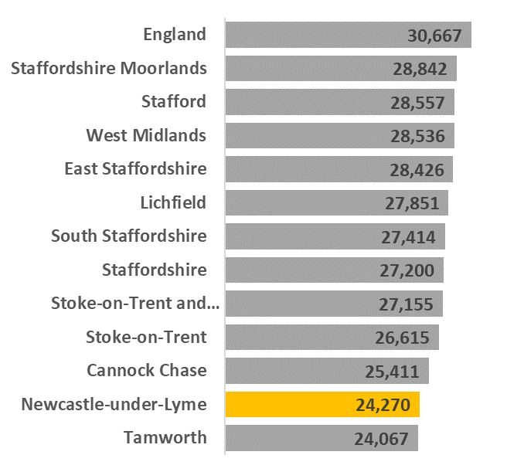
Newcastle lags behind the national average for wages despite seeing improvement since the recession
Resident Earnings
Slower growth than nationally in resident earnings and workplace earnings since the recession, and still well below the national averages
Workplace Earnings
Notes:
Earnings (2019):
Resident earnings now stand at £26,620 and have grown by £3,348 or 14.4% since 2009 – lower proportional growth than nationally (17.3%) and still well below the national average of £30,661
Workplace earnings are currently £24,270 and have grown by £3,369 or 16.1% since 2009 – indication of better paid jobs in Newcastle-under-Lyme which is likely to be a key factor in the growth of resident earnings – but slower growth than nationally (17.3%) and still well below the national average of £30,667
Particularly low male earnings compared to national averages
(Source: Annual Survey of Hours and Earnings (ASHE) 2019)

Slide 9
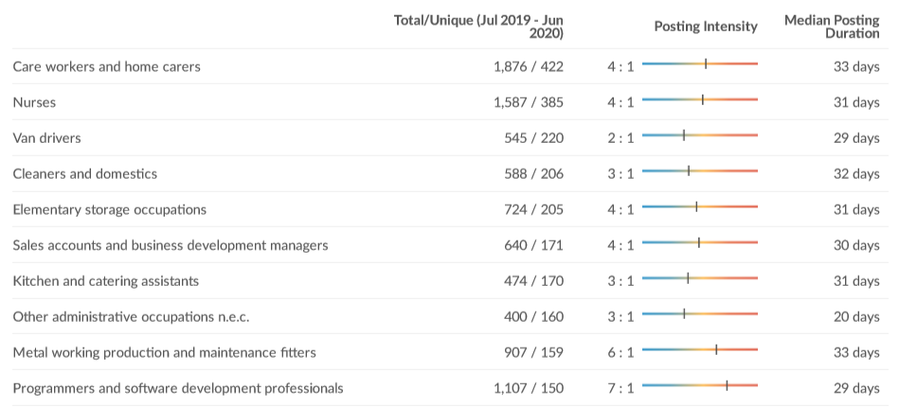
Job Vacancies in Newcastle-under-Lyme
Over 7,200 job vacancies over the last year (July 2019-June 2020)
Median Advertised Salary = £23.0K
Main occupations in demand include:
Notes:
(Source: EMSI)

Slide 10
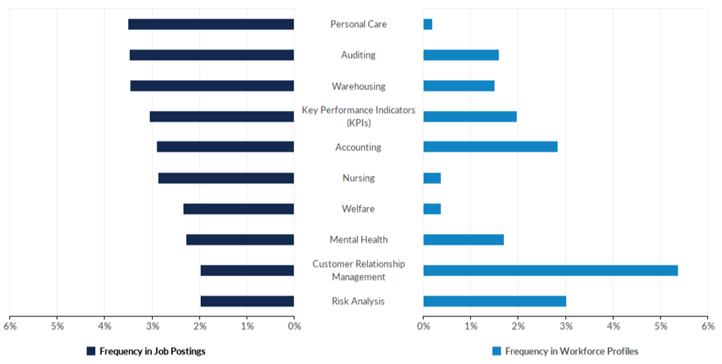
Hard Skills in Demand in Newcastle-under-Lyme
Hard Skills most requested over the last year (July 2019-June 2020)
Notes:
The following provides insight into the supply and demand of relevant skills by comparing the frequency of skills present in job postings against skills present in today's workforce. Along with Emsi's job posting analytics, this comparison leverages Emsi's dataset of more than 100M online resumés and proﬁles. All resumés and proﬁles used in these comparisons have been updated within the last three years.
*The skills associated with workforce proﬁles represent workers of all education and experience levels.
(Source: EMSI)

Slide 11
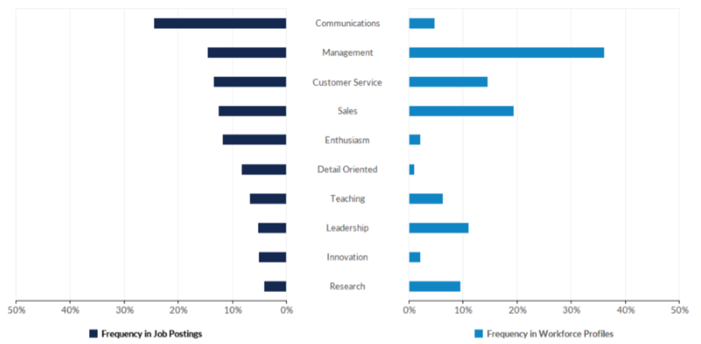
Common Skills in Demand in Newcastle-under-Lyme
Common Skills most requested over the last year (July 2019-June 2020)
Notes:
The following provides insight into the supply and demand of relevant skills by comparing the frequency of skills present in job postings against skills present in today's workforce. Along with Emsi's job posting analytics, this comparison leverages Emsi's dataset of more than 100M online resumés and proﬁles. All resumés and proﬁles used in these comparisons have been updated within the last three years.
*The skills associated with workforce proﬁles represent workers of all education and experience levels.
(Source: EMSI)

Slide 12
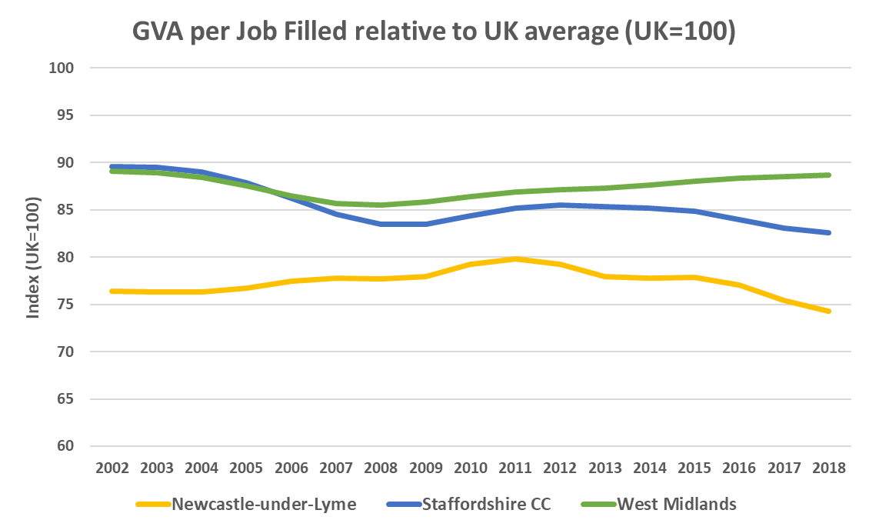
Raising productivity remains one of our biggest challenges
  GVA per job filled in Newcastle-under-Lyme stood at £41,877 in 2018 compared to the UK average of £56,387 – over a quarter less productive
  Newcastle-under-Lyme ranked 8th out of the 8 Staffordshire LAs for GVA per job filled
  Newcastle-under-Lyme has an important role to play in improving overall productivity in the SSLEP area, and can build on recent success in bringing more higher skilled and higher value jobs to the local area
88.7
82.6
74.3
Notes:
(Source: ONS Subregional Productivity 2018)

Slide 13
Adult skills levels are improving for both residents with no qualifications and higher skills but remains below the national averages
Notes:
(Source: Annual Population Survey 2019)
No qualifications: % of adults with no qualifications improved since pre-recession and now stands at 6.9% compared to 7.5% nationally
NVQ Level 3: Since 2014, an additional 5,300 adults with L3+ qualification and but would require an additional 6,300 to reach the national average
NVQ Level 4: Improvement at L4+ with an additional 2,900 adults with such qualifications since 2014, however would require an additional 7,800 adults qualified to NVQ Level 4+ to reach the national average
SEP (2014-2030) - Phase 1 (2014-2018) - new EU ESF Skills Programme started in 2014
Strategic focus on high value high skilled jobs in high-tech industries to help drive economic growth and raise productivity, alongside inclusive economic growth where everyone can benefit from growth in the economy
In order to attract better paid jobs in high value sectors there is a need to improve education and skills in the local area to deliver more higher skilled workers to fill these roles
Adult NVQ Levels - highest educational qualifications of the population
Growth in NVQ3+ and NVQ4+ with a reduction people with no qualifications for Newcastle-under-Lyme – potentially linked to the new EU ESF skills programme investment of £55m (since 2014 to 2020)

Slide 14
Developing local skills is a key priority in addressing the productivity challenge and ensuring more residents can access more good jobs…
KS4: Generally Newcastle-under-Lyme performs well at Early Years and KS2, but KS4 remains an area for improvement performing the 3rd lowest for Attainment 8 out of all Staffordshire LA’s and worse than the national average – inequalities at locality level with wide range in attainment
Pupil Absence/Exclusions: Newcastle-under-Lyme has a similar levels of children who are absent or excluded from school compared to nationally
KS5: Newcastle-under-Lyme performs better than the Staffordshire average for KS5 with the second highest Average Point Score (APS) per Level 3 Qualification of all Staffordshire LA’s but remains below the national average
Higher Education: Participation in HE is similar in Newcastle-under-Lyme (34%) to Staffordshire (35%) and national (37%) averages
Notes:
(Source: Staffordshire County Council 2019)
Focus now on further raising skill levels to support growth in high value, locally important sectors and raising productivity, whilst increasing wages and reducing demand for our services

