Slide 1


Skills and Economic Challenges in Lichfield
Skills and Employability Team,
Staffordshire County Council

Slide 2


Introduction
Provide insight into current and future skills demand and supply challenges in Lichfield

Slide 3
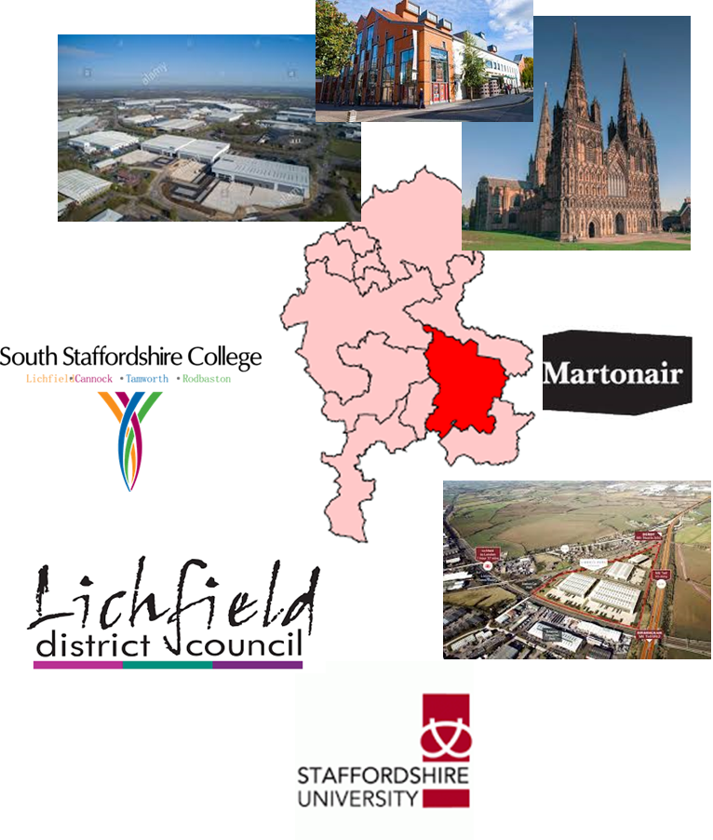
Recent success in creating new businesses and jobs
745 additional businesses since 2011
Business start-up rate is the highest in Staffordshire, but still lags behind regional and national averages
However, businesses are more likely to fail than on average in Staffordshire
8,000 additional jobs since 2011
Higher than the County, regional and national averages for rate of jobs growth since 2011
Notes:
Total Businesses – 4,815 in 2019 (Source: UK Business Counts)
Business start-up rates per 10,000 – Lichfield 62.6 / Staffordshire 47.1 / WM 66.0 / England 75.2
Business death rates per 10,000 – Lichfield 64.3 / Staffordshire 43.8 / WM 55.8 / England 65.9
3 Year business survival rates – Lichfield 58% / Staffordshire 59% / WM 56% / national 55% (declining trend across all areas)
(Source: ONS Business Demography 2018)
Jobs growth rate 2011-2018 = Lichfield (17%) above Staffordshire (12.1%), regional (12.3%) and national (13.5%) averages
Job density (jobs per working age pop) = 2nd highest of all Staffordshire LA’s (0.89) behind only East Staffordshire and higher than the regional (0.81) and national (0.87) averages
(Source: Job Density 2018)

Slide 4
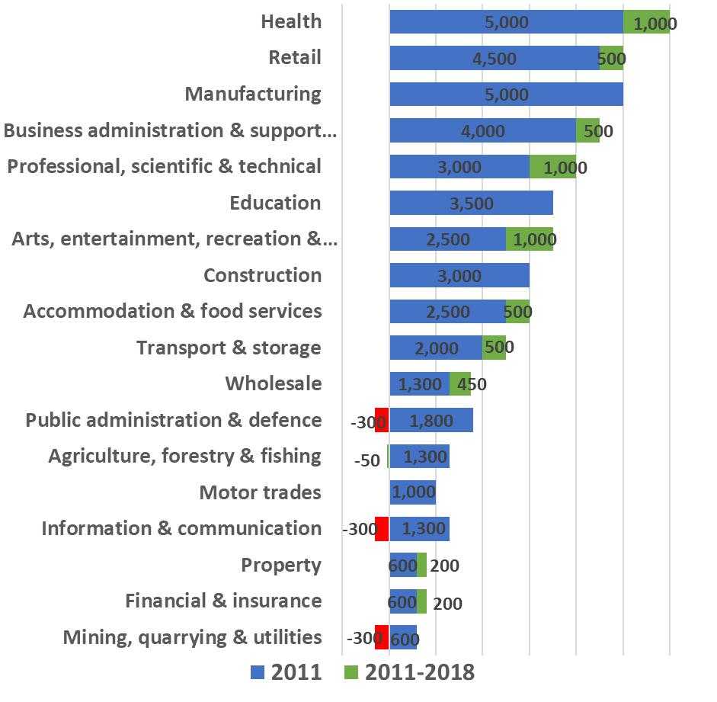
More balanced economy with jobs growth in service based industries and declines in public sector
49,000 jobs in 2018
Largest sectors are health (6,000 jobs), manufacturing and retail (both 5,000 jobs each)
Main post-recession growth in professional, health and arts (all seeing 1,000 growth in jobs)
Clear impact of ensuing austerity in the wider public sector but also some losses in information & communication and mining, quarrying and utilities
Notes:
(Source: Business Register and Employment Survey (BRES) 2018)

Slide 5
Issues with unemployment, economic inactivity and youth unemployment but generally better than the national average
Notes:
Claimant Count Rate (June 2020): 4.9% or 3,000 claiming JSA or Unemployment Universal Credit, in-line with the Staffordshire average (4.9%) and below the national average (6.4%) (Source: DWP Claimant Count)
Economic Inactivity (Apr 2019-Mar 2020): higher level of economic inactivity than Staffordshire and national averages
Lichfield 21.7% / Staffordshire 18.0% / national 20.6% (Source: Annual Population Survey)
Youth Unemployment (aged 18-24) (June 2020): Higher rate of young people (aged 18-24) finding themselves unemployed than the Staffordshire average but lower than the national average - Lichfield 11.0% / Staffordshire 8.3% / national 9.1% - 2,590 18-24 claimants in June 2020 (Source: DWP Claimant Count)

Slide 6
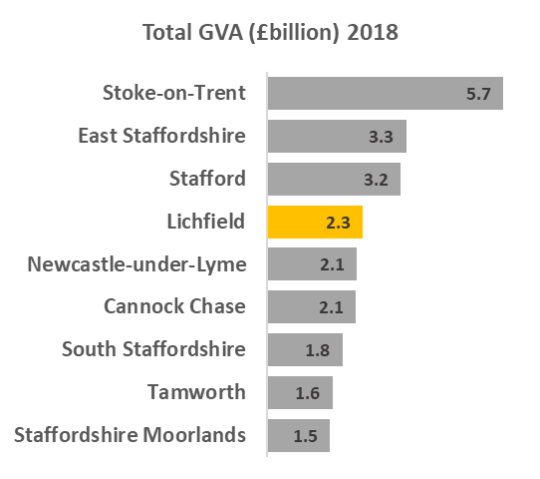
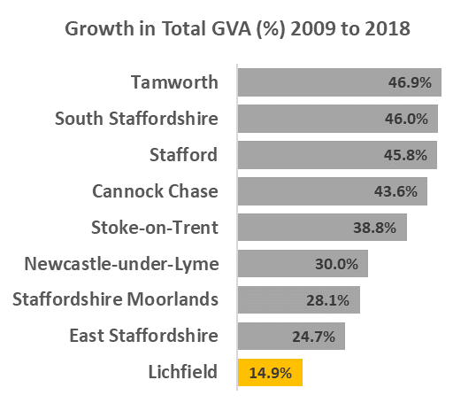
Below average growth in the economy, with main growth in health & social care, manufacturing and construction
WM = 43.4%
UK = 35.5%
Staffs = 33.4%
Notes:
Size of economy 2018: £2.3billion
GVA growth 2009-2018:
Total £298million (14.9%)
Health & Social Care £118million
Construction £116m
Manufacturing £107m
Real Estate Activities £105m
(Source: ONS Regional gross value added (balanced) by local authority 2018)

Slide 7
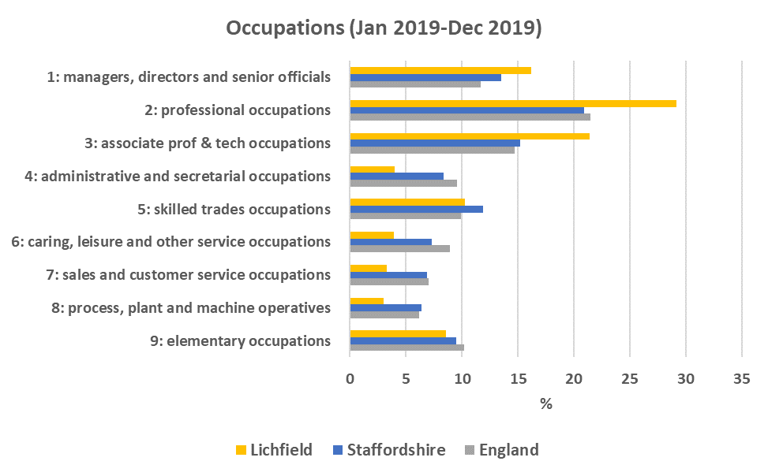
Lichfield has higher than average jobs in higher occupations
Over two thirds (67%) of jobs in Lichfield were in the top 3 occupation groups in 2019, well above the Staffordshire (50%) and national (48%) averages
Notes:
Occupations (2019):
Increase in the % of jobs in the top 3 occupation groups from 41% in 2009 to 67% in 2019 equivalent to 63% or 13,000 more residents employed in these higher occupations and the highest of all Staffordshire LA’s and well above the Staffordshire (50%) and England (48%) averages.
(The top three occupation groups are: ‘managers, directors and senior officials’, ‘professional occupations’ and ‘associate professional & technical occupations’)
(Source: Annual Population Survey)

Slide 8
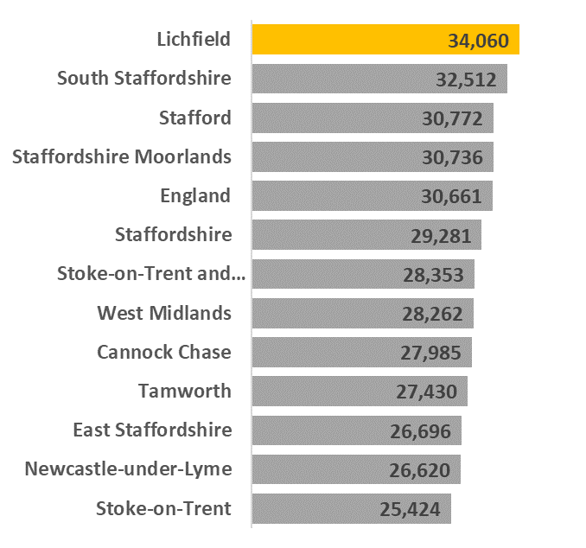
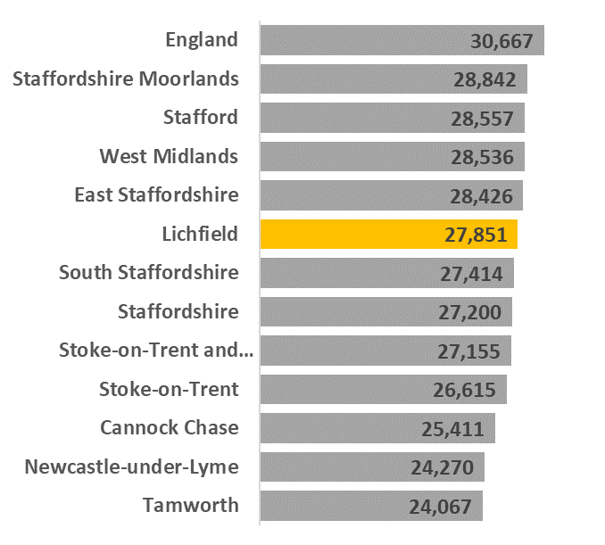
Lichfield performs well for resident earnings but still lags behind the national average for workplace wages
Faster growth than nationally in resident earnings since the recession and the highest in Staffordshire and above the national average but slower growth in workplace earnings since the recession and still well below the national average
Resident Earnings
Workplace Earnings
Notes:
Earnings (2019):
Resident earnings now stand at £34,060 and have grown by £6,075 or 21.7% since 2009 – larger proportional growth than nationally (17.3%) and now above the national average of £30,661
Workplace earnings are currently £27,851 and have grown by £3,360 or 13.7% since 2009 – but slower growth than nationally (17.3%) and still well below the national average of £30,667
(Source: Annual Survey of Hours and Earnings (ASHE) 2019)

Slide 9
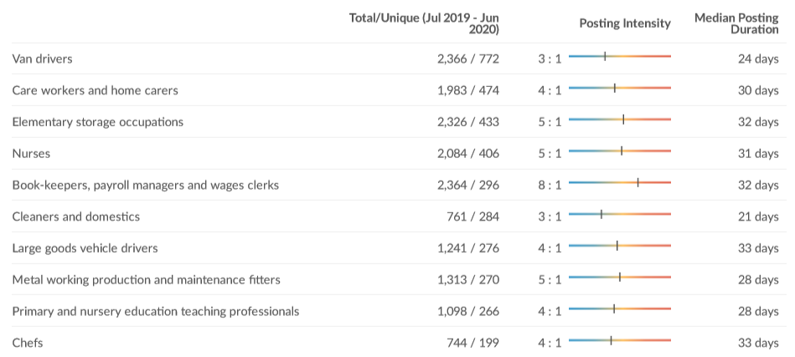
Job Vacancies in Lichfield
Over 11,100 job vacancies over the last year (July 2019-June 2020)
Median Advertised Salary = £24.0K
Main occupations in demand include:
Notes:
(Source: EMSI)

Slide 10
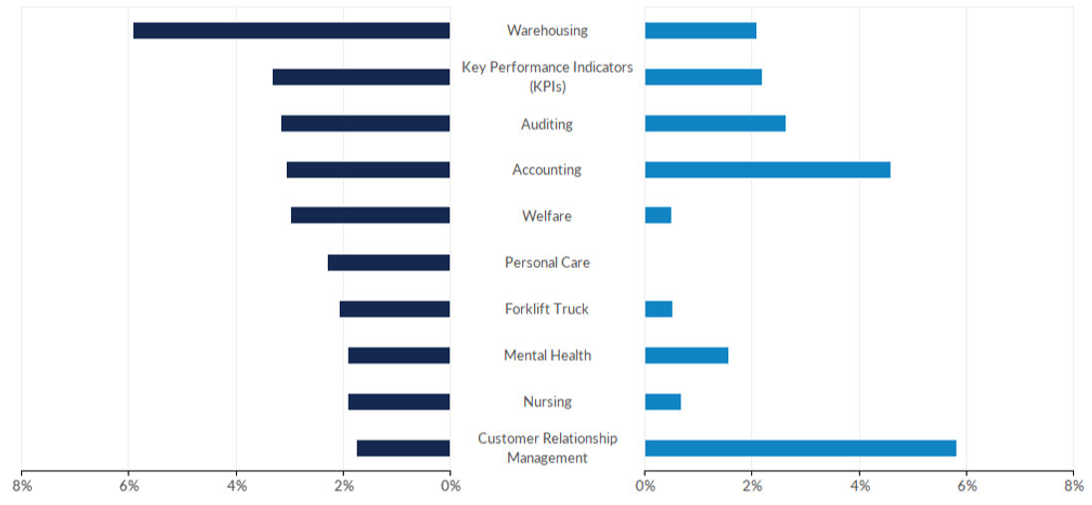
Hard Skills in Demand in Lichfield
Hard Skills most requested over the last year (July 2019-June 2020)
Notes:
The following provides insight into the supply and demand of relevant skills by comparing the frequency of skills present in job postings against skills present in today's workforce. Along with Emsi's job posting analytics, this comparison leverages Emsi's dataset of more than 100M online resumés and proﬁles. All resumés and proﬁles used in these comparisons have been updated within the last three years.
*The skills associated with workforce proﬁles represent workers of all education and experience levels.
(Source: EMSI)

Slide 11
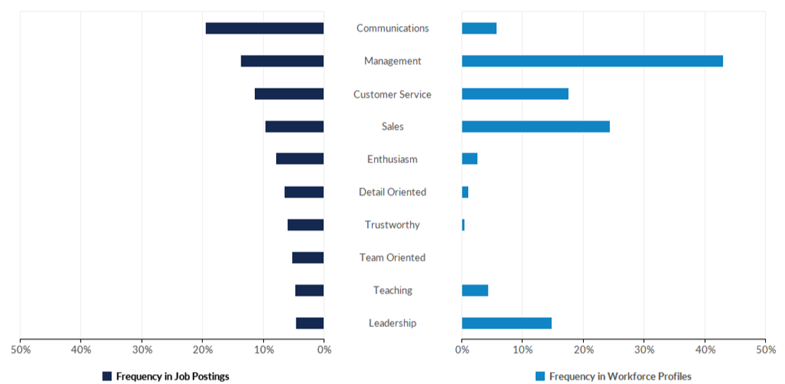
Common Skills in Demand in Lichfield
Common Skills most requested over the last year (July 2019-June 2020)
Notes:
The following provides insight into the supply and demand of relevant skills by comparing the frequency of skills present in job postings against skills present in today's workforce. Along with Emsi's job posting analytics, this comparison leverages Emsi's dataset of more than 100M online resumés and proﬁles. All resumés and proﬁles used in these comparisons have been updated within the last three years.
*The skills associated with workforce proﬁles represent workers of all education and experience levels.
(Source: EMSI)

Slide 12
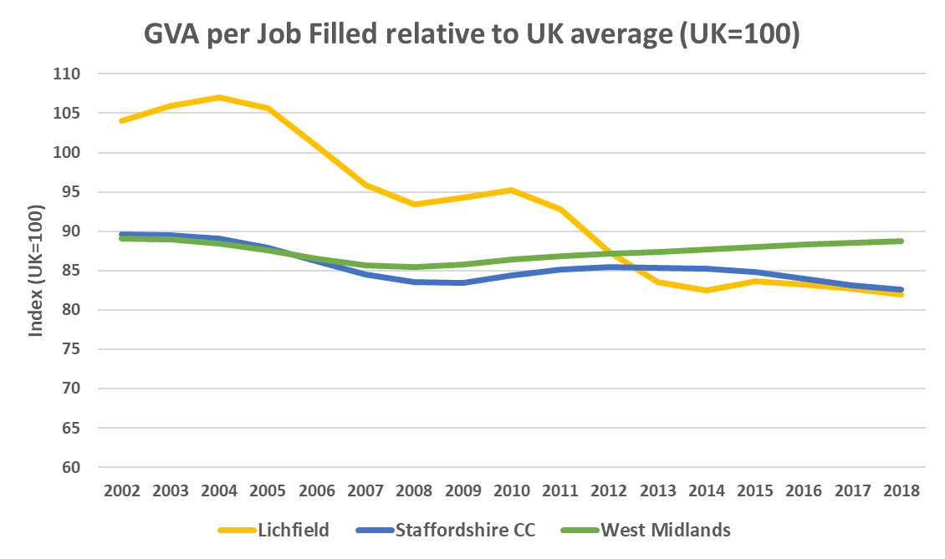
Raising productivity remains one of our biggest challenges
  GVA per job filled in Lichfield stood at £46,223 in 2018 compared to the UK average of £56,387 – nearly a fifth less productive
  Lichfield ranked 3rd out of 8 Staffordshire LAs for GVA per job filled
  Lichfield has an important role to play in improving overall productivity in the SSLEP area, and can build on recent success in bringing more higher skilled and higher value jobs to the local area
88.7
82.6
82.0
Notes:
(Source: ONS Subregional Productivity 2018)

Slide 13
Adult skills levels are generally higher than in other areas and continue to improve to meet increasing demand for higher skills
Notes:
(Source: Annual Population Survey 2019)
No qualifications: long-term improvement in % of adults with no qualifications with a 2,300 decline between 2014-2019 and now well below the national average standing at 5.1% compared to 7.5% nationally in 2019
NVQ Level 3+: % of adults with L3+ qualification stood at 62.0% in 2019 above the national average of 58.5%
NVQ Level 4+: Strong improvement at L4+ with an additional 12,400 adults with such qualifications since 2014 with the % of adults with L4+ qualification stood at 51.2% in 2019 well above the national average of 40.0%
SEP (2014-2030) - Phase 1 (2014-2018) - new EU ESF Skills Programme started in 2014
Strategic focus on high value high skilled jobs in high-tech industries to help drive economic growth and raise productivity, alongside inclusive economic growth where everyone can benefit from growth in the economy
In order to attract better paid jobs in high value sectors there is a need to improve education and skills in the local area to deliver more higher skilled workers to fill these roles
Adult NVQ Levels - highest educational qualifications of the population
Growth in NVQ4+ with a reduction people with no qualifications for Lichfield – potentially linked to the new EU ESF skills programme investment of £55m (since 2014 to 2020)

Slide 14
Developing local skills is a key priority in addressing the productivity challenge and ensuring more residents can access more good jobs…
KS4: Lichfield performs well at Early Years, KS2 and KS4 performing better than the Staffordshire and national averages at all Key Stages (highest performing Staffordshire LA at KS2 and KS4)
Pupil Absence/Exclusions: Lichfield has a lower than average proportion of children who are absent or excluded from school
KS5: Lichfield also performs above the Staffordshire average at KS5 for Average Point Score (APS) per Level 3 Qualification but below than the national average
Higher Education: Participation in HE is higher in Lichfield (41%) than the Staffordshire (35%) and national (37%) averages, associated to comparatively good KS4 performance and higher levels of FE progression
Notes:
(Source: Staffordshire County Council 2019)
Focus now on further raising skill levels to support growth in high value, locally important sectors and raising productivity, whilst increasing wages and reducing demand for our services

