Slide 1
Local Industrial Strategy: Insights Pack September 2019

Slide 2
Contents
About this pack
Introduction to Industrial Strategy
Timeline
Headlines from the evidence
Future opportunities for business growth
Questions

Slide 3
About this pack
Local Authorities, business groups, universities and colleges in Stoke-on-Trent and Staffordshire are working together to develop a plan for how future investment can best support our communities and businesses to succeed.
Led by the Stoke-on-Trent and Staffordshire Local Enterprise Partnership we are creating a Local Industrial Strategy (LIS) for the area. Our goal is to increase the number of new and growing businesses, improve productivity and so increase the numbers of good jobs and opportunities.
It will be the blueprint for how we invest public money in our economy, setting out how we build on what makes our area a great place to start a business, invest, live, work and succeed.
We have undertaken a lot of research into how our economy works, its strengths and weaknesses, and the distinctive contribution that people and firms here make to the UK economy as a whole. This pack sums up some of that research and ask some questions. We are keen to hear your views and get your ideas. No-one understands this place better than the people who live and work here.
Please share your views using the links at the end of this pack.

Slide 4
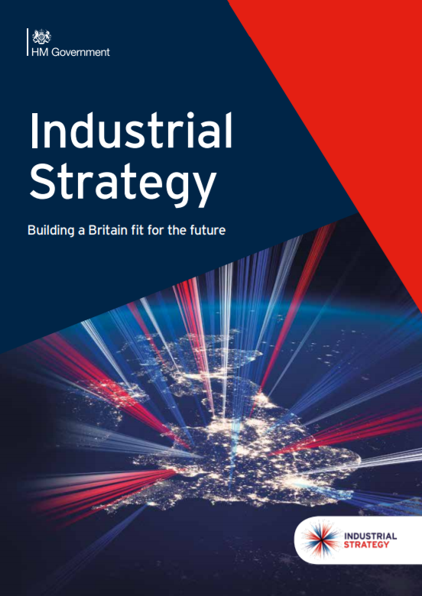
Introducing Industrial Strategy
- Government published the national Industrial Strategy in 2017.
- It set out range of proposals to tackle the UK’s productivity challenge.
- It led to a series of “Sector Deals” and funding from Government.
- Each local area was asked to write their own Local industrial Strategy by March 2020.
- New Government remains committed to productivity improvements and an economy that works for all our places and communities.
Notes:
In November 2017 Government published a National Industrial Strategy White Paper. It set out national policy aims for tackling the UK’s long-standing productivity issues and also described four “Grand Challenges” that would both drive growth and require firms and society to adapt and adopt new approaches.
The White Paper is the latest in a long history of varying national approaches to industrial policy in the UK. In the light of the Brexit referendum and major technological, demographic and climate change it signals a switch towards a slightly more interventionist national approach, although it is not clear the extent to which all Whitehall Departments are bought in to the implications.
It sets out a broad framework rather than a specific set of policy changes.

Slide 5
Productivity and Grand Challenges
Government has asked us to address five aspects of the economy that are core to improving productivity and future growth:
Grand Challenges
Artificial intelligence and data
Ageing society
Clean growth
Future of mobility
And to consider four Grand Challenges driven by technological and demographic trends and changes in global markets and the environment
Notes:
This slide sets out the main aims and elements of the Government’s National Industrial Strategy
It looks at productivity through 5 Foundations, which are well established drivers of the national and local economy:
Ideas – innovation
People – Skills and earnings, the labour market
Infrastructure - including digital
Business Environment – business support and finance
Places
It also sets out 4 challenges which the UK and global economy faces, with a mission for the UK economy and firms to adapt and play a leading role in each:
AI and Data
Ageing Society
Clean Growth
Future of Mobility
The Government also asked each place, led by LEPs or Combined Authorities, to prepare a local industrial strategy by March 2020. The primary purpose of the local industrial strategy is to set out how future growth and productivity gains can be achieved in ways that benefit the whole population and, crucially, to start to make the case for future growth funding, once the current round of UK and EU growth funding is complete.
It asks that these strategies are approved with Government and are specific about the distinctive contribution and strengths that each place can offer.
It is not yet clear what funding for growth and infrastructure is gong to look like post March 2020. But our industrial strategy is an important opportunity to show Government the future potential of the Norfolk and Suffolk economy and why it makes sense for private and public investment to come here.
Really importantly, the industrial strategy is not just a public sector strategy. Taking the opportunities and meeting the challenges ahead, say on labour or automation, is going to mean business of many sectors are going to have to change, adapt and invest. This strategy has to show how and how they can be helped to do so.

Slide 6
Timeline
Evidence base
Engagement / Action planning
Drafting
Sign-off with government
Economic data analysis
Workshops to develop interventions
Production of action plan
Collaboration with Gov on final draft
March – June 2019
Autumn / Late 2019
Publication
June – November 2019
Early 2020
Business / partner interviews
Testing with partners
Draft to Government
Local Implementation begins

Slide 7
Stoke-on-Trent and Staffordshire – facts and figures
We have a population of 1.1m which has grown by 2.5% since 2011. Overall our population is older than the national average, but Stoke-on-Trent has a younger population than average.
We have 485,000 jobs. Employment has grown by 9.6% since 2009, adding 42,340 new jobs. But wages for residents have not grown as fast as the national average.
Our economic output (GVA) is £21.5bn and has grown by £1.8bn in the last 5 years. Productivity is a challenge, with output per hour at £25.90, the 3rd lowest of all Local Enterprise Partnership areas.
We are home to 38,790 businesses, including 145 large businesses employing over 250 employees.

Slide 8
Our economy has added lots of jobs but employment and wage growth is slower than elsewhere
Indexed Total Employment, 2009-2017 (2009 = 100)
Since 2009, the total number of jobs has increased by 42,300 or 9.6%. But employment growth has been slower than the West Midlands and national averages (both 10.9%).
Too many of our jobs are in low-wage businesses and sectors. Median earnings for people who work in our area are 12% below the national average.
Growing numbers of jobs
Low business start-up rates
Source: ONS Business Register & Employment Survey. Median wage data is from ONS Annual Survey of Hours & Earnings.

Slide 9
We have a long history of highly innovative business sectors…
Manufacturing employment growth in our area has accounted for half of all recent national manufacturing employment growth. We are well-connected and an important part of national and global supply chains.
We are a sought-after location for modern logistics and have added thousands of new jobs over the last decade.
We are home to nationally significant energy projects and expertise in energy distribution and management .
We have a growing number of digital jobs across our all areas of our economy, and a growing business service sector.
We have nationally important strengths in our food businesses and agri-tech.
We are the home of ceramics in the UK at Stoke-on-Trent – encompassing well-established international brands as well as highly technical ceramic components and advanced materials.

Slide 10
Which sectors are growing ?
Declining sectors
Growing sectors
More concentrated sectors (LQ>1)
Further education
Unlicensed couriers
Some manufacturing sub-sectors
Brewing
Some retail sub-sectors
Logistics
(B2B) Catering
Local services/Sports/Leisure
Health & care
Equipment / JCB
Gambling
Less concentrated sectors (LQ<1)
Education
Social care
Policing
High street banks
Professional services
Business services
Automotive manufacturing
Real estate
Housebuilding
IT
Hotels
Source: BRES employment data, 2009-2017. Analysis by Metro Dynamics.

Slide 11
We can further improve growth and productivity
Indexed Economic Output (measured in Gross Value Added / GVA), 1998 to 2017 (1998 = 100)
According to the most recent figures, the economic output of Stoke-on-Trent and Staffordshire LEP is £21.5bn. This is 16.5% of the economic output for West Midlands region, and 1.2% of UK output.
Since the 2009 recession, growth in SSLEP has been slower than the national and regional averages.
After initially keeping pace with the national economy, productivity is now slowing down.
In 2017, economic output per hour worked was £25.90 in SSLEP. This is 22% lower than the national average. More worryingly, the productivity gap in SSLEP has widened over recent years.
For the LEP area as a whole, there are no sectors which have higher productivity (as measured by GVA per job) than the national average. This means that raising productivity is an economy-wide challenge.
Source: ONS Regional gross value added (balanced) local authority by NUTS 1 region. Note: all economic output figures cited here refer to GVA.

Slide 12
We are a good place to start a business, but we have fewer businesses than we would like.
Businesses per 10,000 people, 2018
The LEP area is home to 38,790 businesses, including 145 large businesses employing over 250 employees.
There are fewer businesses here than there could be. There are 410 businesses per 10,000 residents in the SSLEP area, which is below the West Midlands (425) and England (482).
SSLEP has a slightly better survival rate for new businesses than England and the West Midlands, from one year after establishment through to five years. This suggests that the LEP area is a good place to start a business and a supportive environment to maintain it.
Source: Source: Business Demography 2017: Count of Births of New Enterprises; ONS Population Estimates.

Slide 13
Skills levels have been rising, but we have fewer people with high skill levels compared to other areas
Qualifications level change in SSLEP area (2004-18)
Skills levels across the population are rising. Between 2004 and 2018 the proportion of the population with degree level or higher (NVQ4+) skills rose from 20.4% to 33.4%. However, the area still has a lower proportion of the population with NVQ4+ skills than the UK (39.2%).
Residents in our area earn more than people who work in our area do. This suggests that some of our higher-skilled residents commute outside the area to work- finding higher paying jobs in neighbouring economies.
Source: Annual population survey:

Slide 14
Average levels of R&D investment are low
Business Enterprise R&D Expenditure per FTE by LEP area (£) (2013)
Stoke-on-Trent and Staffordshire has strong universities which are active in the local area. Both universities support important spin out activities. Keele has generated strong IP revenues, whilst Staffordshire University has an impressive record of supporting Graduate start ups.
There are also many highly innovative firms dotted all over the patch.
But average rates of R&D investment are low, and the wider business base could be encouraged to invest. Whilst SSLEP area had R&D expenditure of £422 per full time equivalent (FTE) employee, neighbouring Cheshire & Warrington LEP (a relatively strong performer in business R&D terms) recorded expenditure of £2,716 per FTE - or more than six times as much.
R&D tax credits, in the last two years for which we had data, cited expenditure totalling £170m or just 3.4% of the total West Midlands amount (approx. £5bn).
Source: BIS (2015) Mapping Local Comparative Advantages in Innovation

Slide 15
We have major assets and opportunities to drive future growth
Stoke-on-Trent and Staffordshire has room to grow, in terms of the potential of our people and businesses, the availability and affordability of commercial land and premises, housing and its strong connectivity.
We are extremely well connected by rail, road and air. Close to major national centres of growth and global markets.
We are a location of choice for nationally and internationally significant businesses: Jaguar Land Rover, JCB, Bet 365, Amazon, Michelin, General Electric, Pirelli, Fed Ex, and many others.
We are home to three important universities: Keele University, Staffordshire University and Wolverhampton University’s campus at Burton. These universities help drive innovation and spin-outs.
SSLEP’s places are well connected to London, the West Midlands, East Midlands and North West. We have strategic connections to the road and rail networks which support our businesses and are set to benefit from HS2.
We are a diverse place with a growing city, attractive towns, and extensive natural assets.

Slide 16
Putting this together: Emerging vision and priorities
The UK’s most highly connected, inclusive economy. A centre for new businesses and entrepreneurs, using digital, transport and energy networks to drive growth and ambition through innovation, scale up businesses, inward investment and raising enterprise.
Ideas
People
Infrastructure
Business environment
Place
Increased business capacity to absorb and adopt. Growing existing centres of excellence – as leaders in logistics, energy use and manufacturing
Raising wages, skills and ambition - a place where providers and industry collaborate & people and firms get the retraining and technical / digital skills needed.
A business start up and growth hot spot – with increasing productivity and enterprise levels, and sustainable energy and resource use
Repurposing / revitalising our town centres and city – commercial offer and excellent quality of life
Maximising the impact of local energy networks, digital connectivity, and future logistics innovation
Advanced Man
Auto, Aero, Rail
Advanced materials
Med Tech
Business services
Energy
Agri / Food
Business & leisure tourism
Logistics Future mobility
Creative, Games, Designer-Makers
Addressing national Grand Challenges using local expertise: Clean Growth and Future Mobility
– a centre of energy and logistics innovation based on AI/Digital skills and technology

Slide 17
Questions
Have we captured the right competitive advantages, have we missed anything? If so what?
From your perspective what are the main business opportunities and challenges ahead? How could these opportunities improve productivity and business growth?
What actions must businesses take to adapt and take those opportunities? How can the public sector help? – please provide the what, how, who and when.
To have your say, please follow this link: https://www.surveymonkey.co.uk/r/FT2CS3W

