Slide 1
How the environment supports the aims of the LEP
Presentation to Stoke and Staffordshire LEP – June 14th

Slide 2
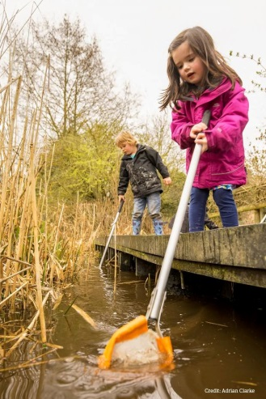
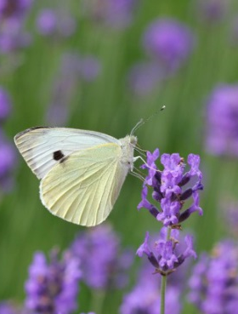
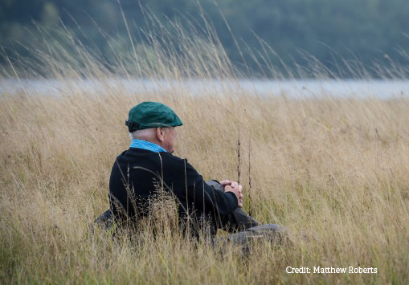
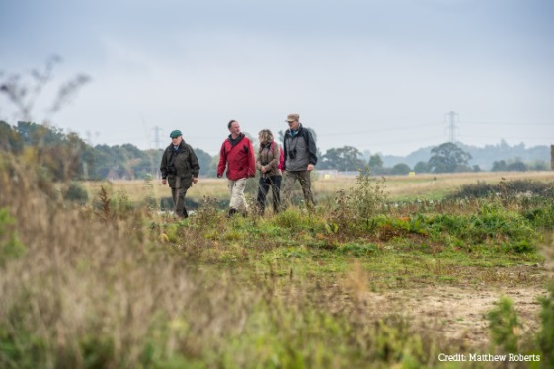
Context
1. Natural Capital and ecosystems services
2. Government’s 25 year plan for the environment
A reduced risk of harm from
environmental hazards such as flooding
and drought
Using resources from nature more
sustainably and efficiently
Enhanced beauty, heritage and
engagement with the natural
environment
Clean air
Clean and plentiful water
Thriving plants and wildlife

Slide 3
The case for the environment
The capital value of ecosystems in Staffordshire is at least £7.19 billion
The services these ecosystems provide are worth at least £111 million a year
Natural flood regulation services provided by habitats in Staffordshire are worth £14.5 million a year
Monthly or more frequent use of urban green spaces can be valued at between £112 and £377 annually per person in terms of health benefits
An assessment of the county’s parks and nature reserves collectively found these sites offer more than £3.3 million annually per person in terms of health benefit
Notes:
I

Slide 4
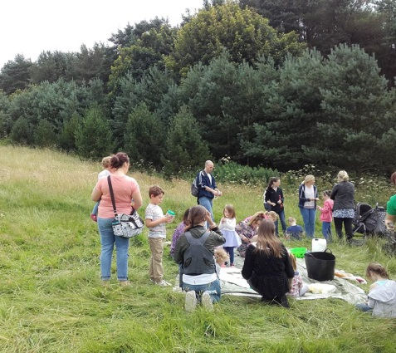
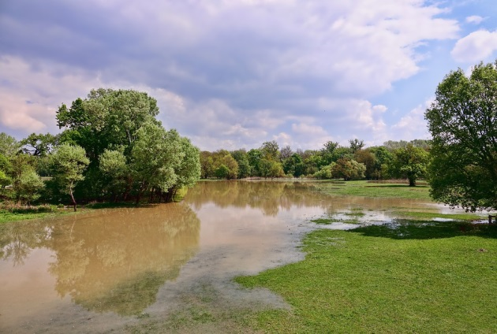
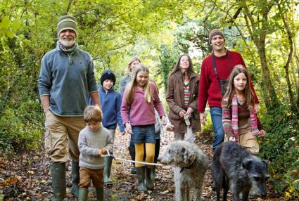
On the ground in Stoke and Staffordshire
Partnership with environmental sector can help:
Facilitate infrastructure and housing development planning to create world class urban development
Underpin practical projects to support economic development e.g. flood mitigation projects
Investment in environmental agenda as part of a wider quality of life/tourism offer for the county

Slide 5
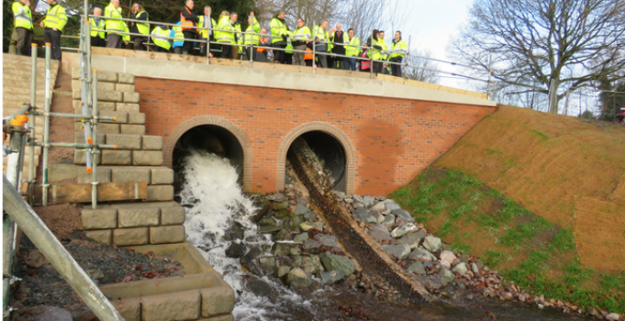
Case study
Rugeley Flood Risk Management Scheme - £5.2m (CC/DC/LEP)
Reduced risk of flooding to 114 residential and 159 commercial properties
Help unlock Rugeley’s potential for growth, attracting investment and creating jobs
Conservatively anticipated to lever in £11.7m in retail/commercial/mixed use schemes and £11.5m private sector investment in housing sites.
A site has applied for planning permission since the scheme was constructed, creating 60-100 jobs

Slide 6
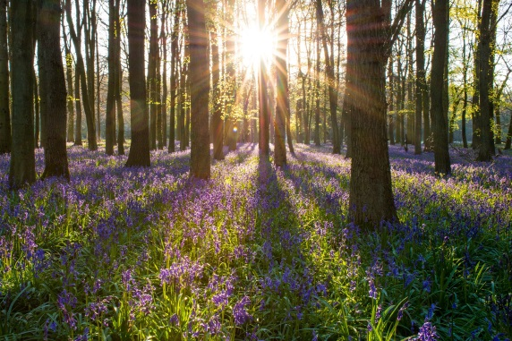
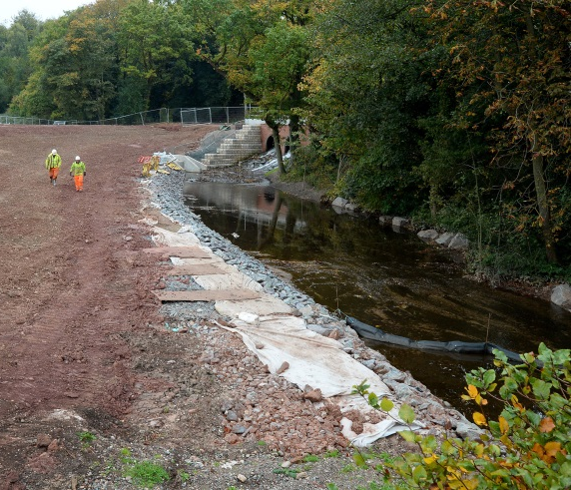
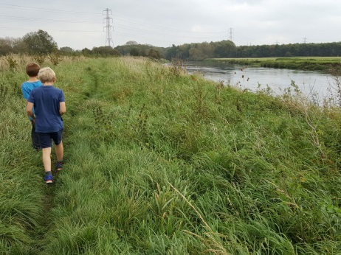
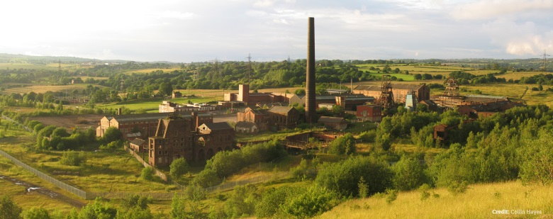
Case study
Sunrise: Delivering a network of green and blue infrastructure improvements across Stoke and urban Newcastle - £3.5 million (ERDF)
Better housing developments
Improved woods, grasslands, and waterways (200 hectares of improved habitats & 25 km of improved river corridors
Better flood mitigation and management of pollution
Related health and well-being benefits for residents
High reputational value

Slide 8
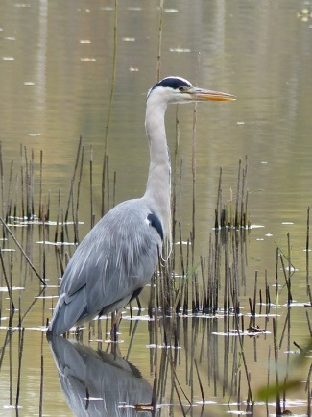
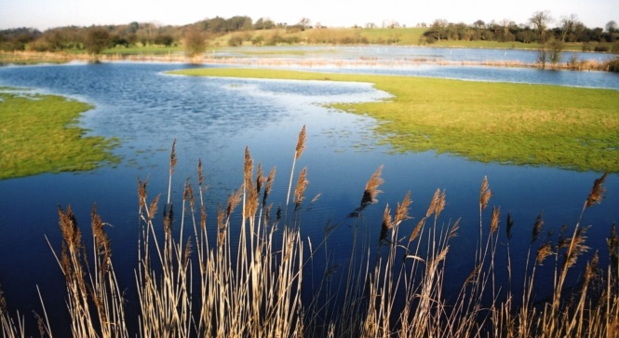
Case study
Transforming the Trent Valley - £3 million (HLF)
Improved habitats for wildlife
Restored cultural and historical landmarks
Better recreational facilities for locals and incoming tourists
Related health and well-being benefits
High reputational value

