Slide 1
Discussion
In our Strategic Economic Plan we set our ambition to see more jobs, higher paid jobs, and more productive jobs. How do we see this being achieved? Should we be equally focussed on attracting prosperous residents as well as employers? What should we be doing to attract and retain skilled residents?

Slide 2
Some data
Vacancy data for the county
Specialist skill data
Salary data
Earnings – workers v residents

Slide 3
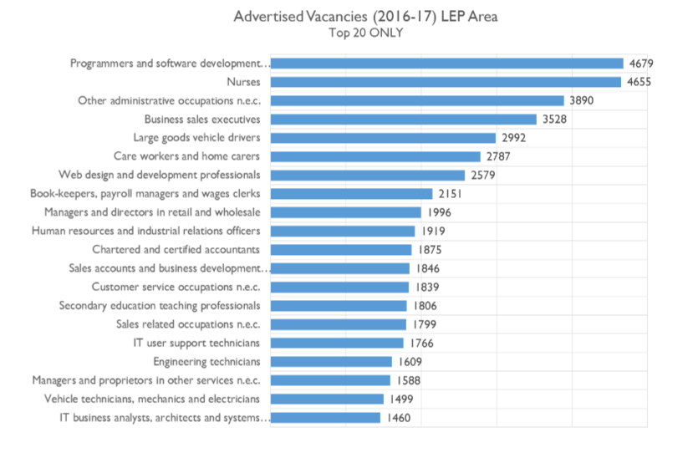
Vacancy data
Alun's Summary of the data
Alun's general roles | Consolidated |  |  |  | Total
Digital | 4679 | 2579 | 1766 | 1460 | 10484
Business administration | 3890 | 2151 | 1919 |  | 7960
Nursing and social care | 4655 | 2787 |  |  | 7442
Sales | 3528 | 1846 | 1799 |  | 7173
Senior management | 1996 | 1875 | 1588 |  | 5459
Engineering technicians | 1609 | 1499 |  |  | 3108
LGV | 2992 |  |  |  | 2992

Slide 4
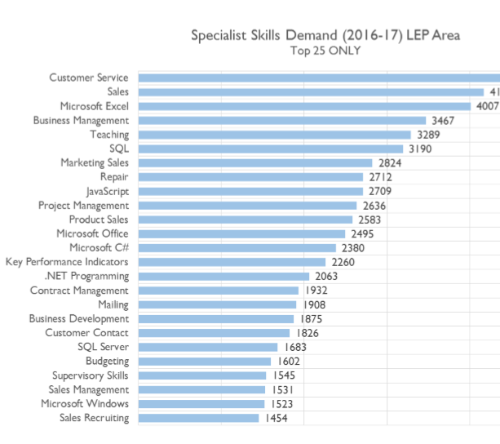
Specialist skills
Alun's general skill areas | Consolidated |  |  |  |  |  |  | Total
Sales | 4981 | 4165 | 2824 | 2583 | 1875 | 1826 | 1454 | 19708
Digital - technical | 3190 | 2709 | 2380 | 2063 | 1683 |  |  | 12025
Senior management | 2636 | 2260 | 1602 | 1545 | 1531 |  |  | 9574
Digital - productivity | 4007 | 2495 | 1523 |  |  |  |  | 8025
Business management | 3467 | 1932 |  |  |  |  |  | 5399

Slide 5
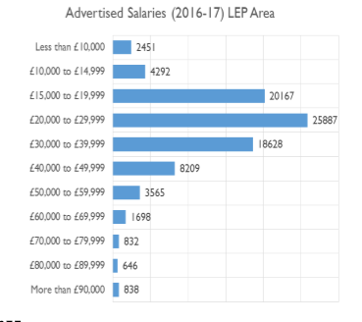
Salary data
Alun's general salary bandings | Consolidated |  |  |  |  |  |  | Total
Above national average | 18268 | 8209 | 3565 | 1698 | 832 | 646 | 838 | 34056
Below national average | 2451 | 4292 | 20167 |  |  |  |  | 26910
Around the average | 25887 |  |  |  |  |  |  | 25887

Slide 6
BI dashboard
https://app.powerbi.com/view?r=eyJrIjoiYjNlMGY5ZDktMWU1Ni00NGZmLWJmY2UtNDk2OWFhZWViNDRjIiwidCI6ImVhYjMyZjY2LTgzYjItNDBhYS1hMDgwLWIyYjA2YzJhMzMzOCIsImMiOjh9

Slide 7
Inspiration from others
http://www.whatworksgrowth.org/
Things that generally make an impact
Apprenticeships
Broadband
Other things which can make an impact sometimes
Business advice
Employment training
Training
Others that do and don’t work
Finance
Area based initiatives
Estate renewal
Innovation
Public realm
Sport and culture
Transport
Notes:
Key thing is that other initiatives can work, but they need more thought and something extra in their execution
Also the research is focused on very big things and often concludes that they couldn’t measure an economic impact but there were other benefits such as health and wellbeing for Sport and Culture

Slide 8
Points for discussion
Views on what was presented this evening
1
How do we think we should direct policy?
2
How do we think we could shape our Strategic Economic Plan?
3
What innovation do we think we could bring?
4
How could we execute plus?
5

